Slide 1
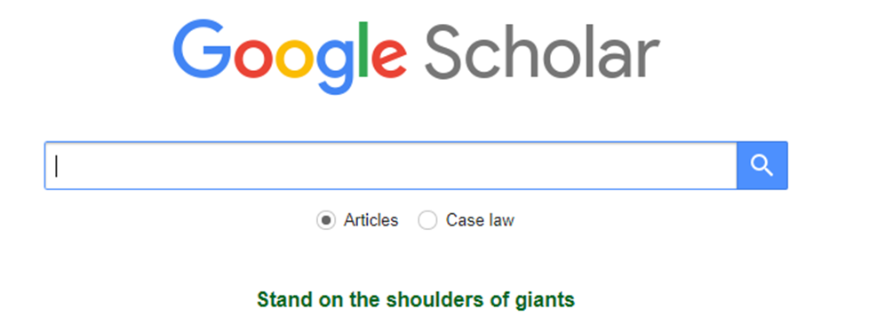
How to use Google Scholar

Slide 2
CONTENTS
1
4
Introduction
Literature Management
2
5
Literature Search
Examples
3
6
Literature Limit/
Literature Expansion
Conclusion

Slide 3
1. INTRODUCTION
1.Brief Introduction
2.Google & Google Scholar
3.Precautions

Slide 4
1. Do you know Google Scholar?
Google Scholar (GS) is a free academic search engine.
It searches repositories of publishers, universities or scholarly websites.
Most of the results of a search tend to be reliable scholarly sources. However, Google is also less careful than academic databases such as Scopus and Web of Science.
So it is worth making your own assessment of the credibility of the resources linked through Google Scholar.

Slide 5
2. Google & Google scholar
There are a number of useful differences from a regular Google search, such as
the option to copy a formatted citation in different styles including
APA (American Psychological Association)
MLA (Modern Language Association)
…
export bibliographic data (BibTeX, RIS) to use with reference management software.
links that let you explore which other works have cited the listed work.
Better than "normal" Google for finding research papers.

Slide 6
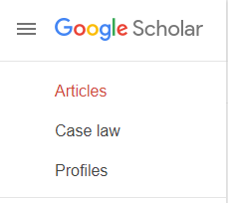

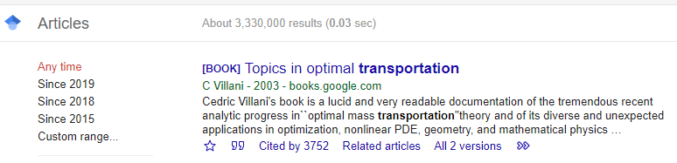
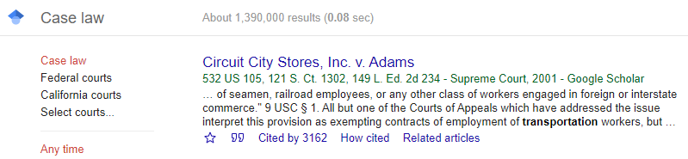
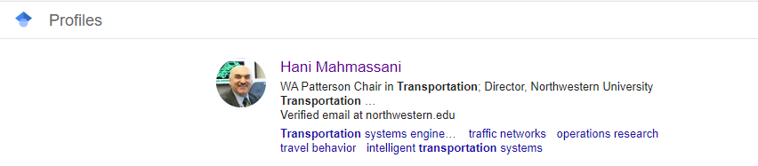
Search scholarly literature
such as journals, books, books chapters, book reviews, patents, conference proceedings, theses…...

Slide 7
3. Precautions
Google Scholar will search for simple plurals automatically but does not use truncation.
Google Scholar searches are not case sensitive “Machine Learning”=“machine learning ”.

Slide 8
2. LITERATURE SERCH
1.Key words
2.Pharses
3.Synonyms
4.Boolean Operations
5.Advanced search

Slide 9
1. Key words
Conceptualize your research question and use keywords instead of full sentences.
E.g.1:
“what is the relationship between link travel time and traffic flow in steady state?”

Slide 10
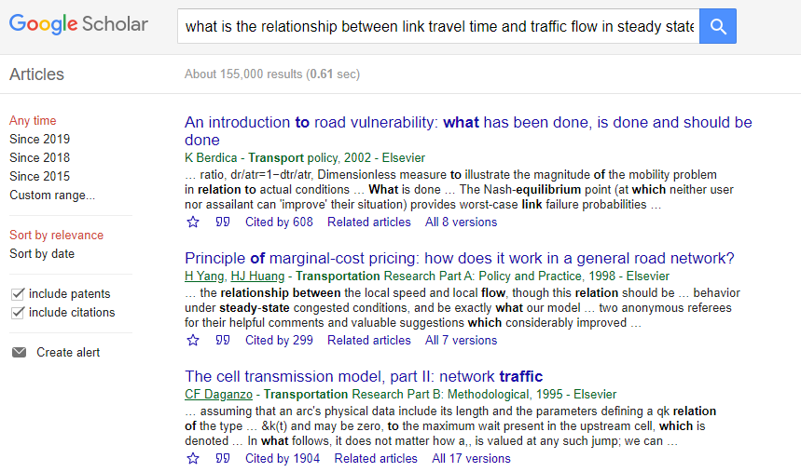
1. Key words
Full sentences searching......

Slide 11
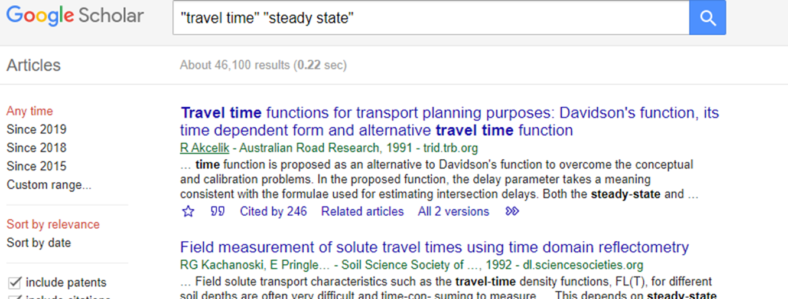
1. Key words
So what about the key words?
“what is the relationship between link travel time and traffic flow in steady state?”

Slide 12
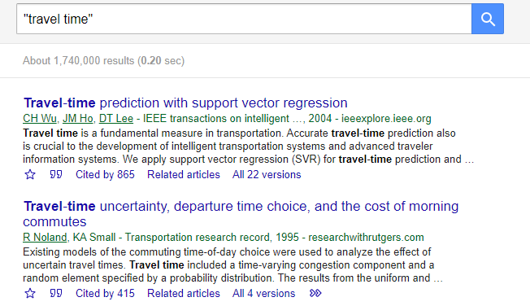
2. Phrases
Use quotes to search for an exact match.

Slide 13
3. Synonyms
Include synonyms and alternative terms in your search.
Key words | Other relevant synonyms
Travel time | Journey time | Transit time | Traveling time | etc.
Traffic flow | Vehicular flow | Traffic stream |  | etc.
Steady state | Stable state | Stable condition | Steady condition | etc.

Slide 14
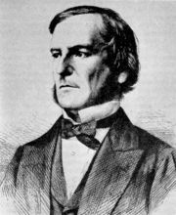
4. Boolean Operations
To combine words and phrases into search queries that will result in more relevant material.
AND :limits your search (often preset in most search engines)
OR: expands your research
NOT : ‘-’
E.g.2:
The user equilibrium of dynamic traffic assignment model or formulation, while system optimal is excluded.

Slide 15
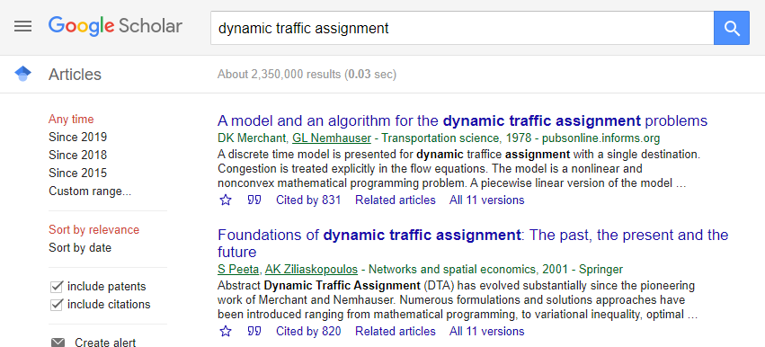
4. Boolean Operations-And
Default to the “AND” operator :the space between the key words represents the word “AND”.
AND

Slide 16
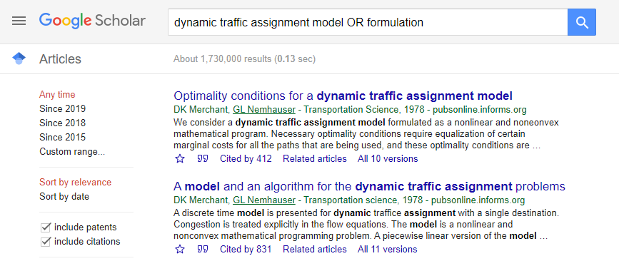
4. Boolean Operations-Or
Expand your research: find articles with at least one words.
OR

Slide 17
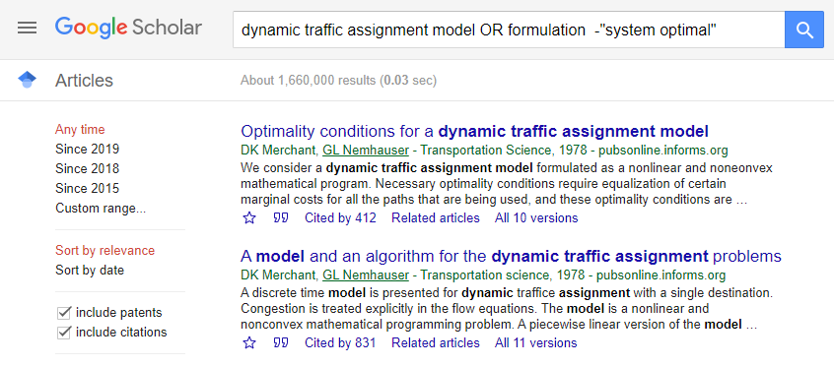
4. Boolean Operations-Not
Limit your research: find articles with at least one words.
NOT

Slide 18
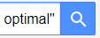
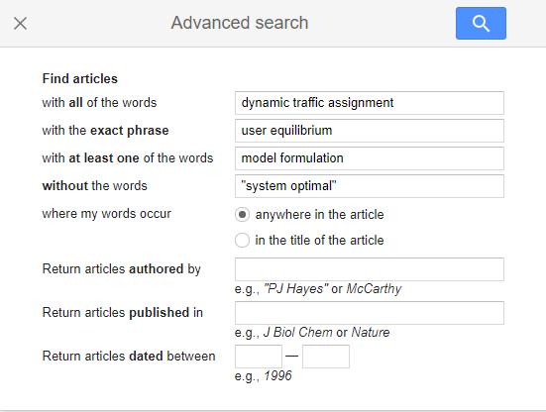
5. Advanced search

Slide 19
5. Advanced search
“Find articles with all words” included but not necessarily in the specified order.

Slide 20
5. Advanced search
Articles with the words in the exact order.

Slide 21
5. Advanced search
Articles with at least one words-invisible OR between the words.

Slide 22
5. Advanced search
NOT: “-”

Slide 23
5. Advanced search
With specific author and journal
Within a certain time

Slide 24
3 LITERATURE LIMIT/EXPANSION
1.Literature Access
2.Literature Limit
3.Literature Expansion

Slide 25
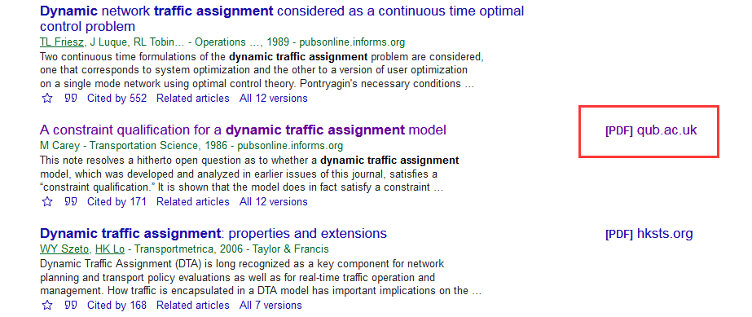
1.Literature access
Google finds copies of restricted articles in public repositories which often contain earlier drafts (preprints), but some of the content is not freely available. So turn to your university library or other access to the licensed sources.

Slide 26
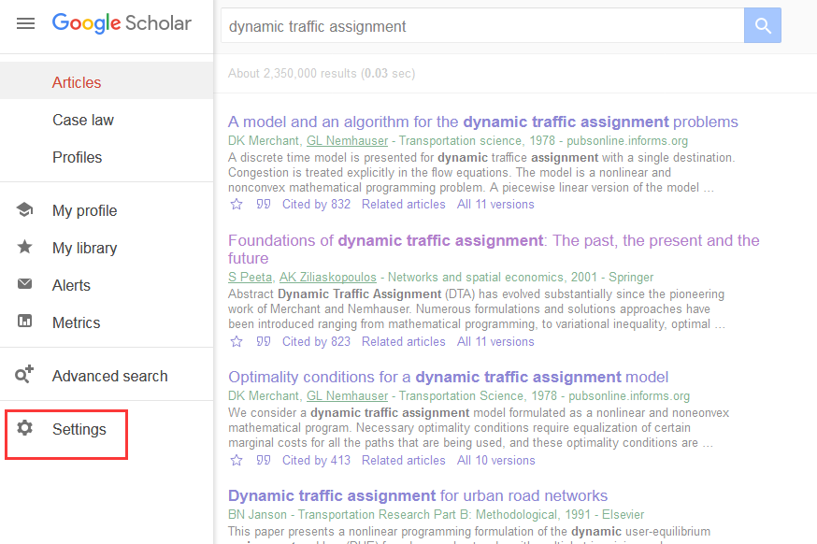
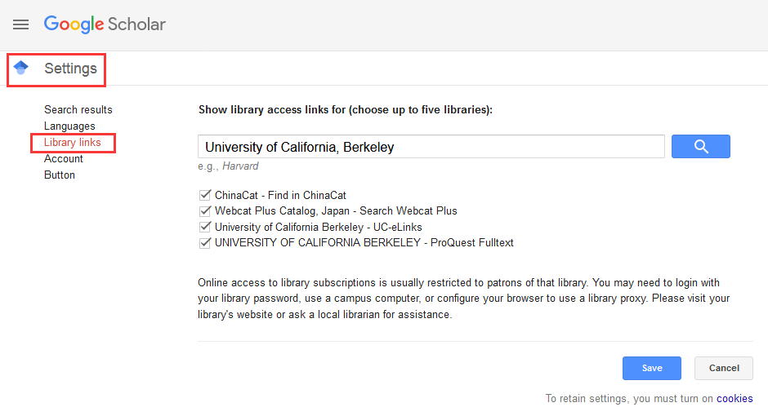
1.Literature access
Library links setting as follow.

Slide 27
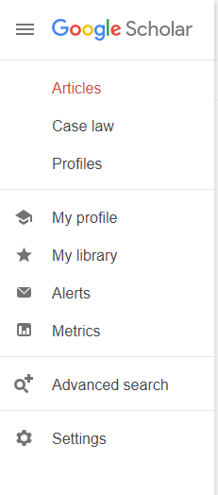
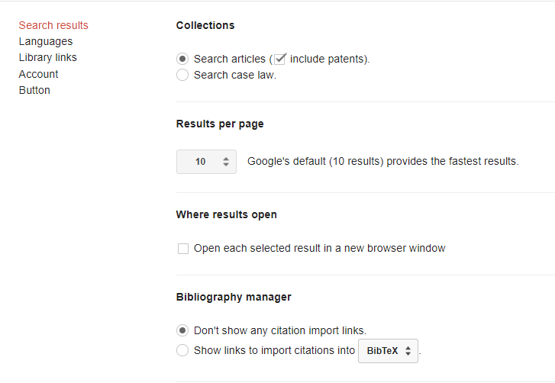
2.Literature limit
Customize search preferences and options.

Slide 28
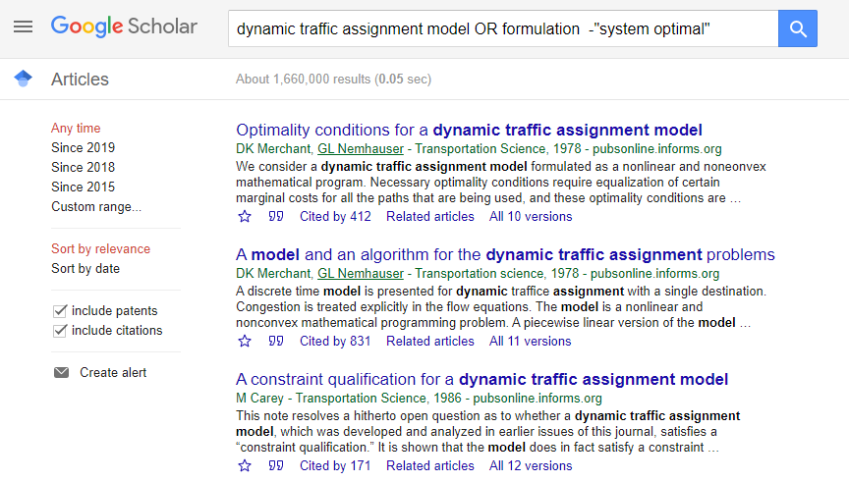
2.Literature limit
Set time limitation and the way articles sorted.

Slide 29
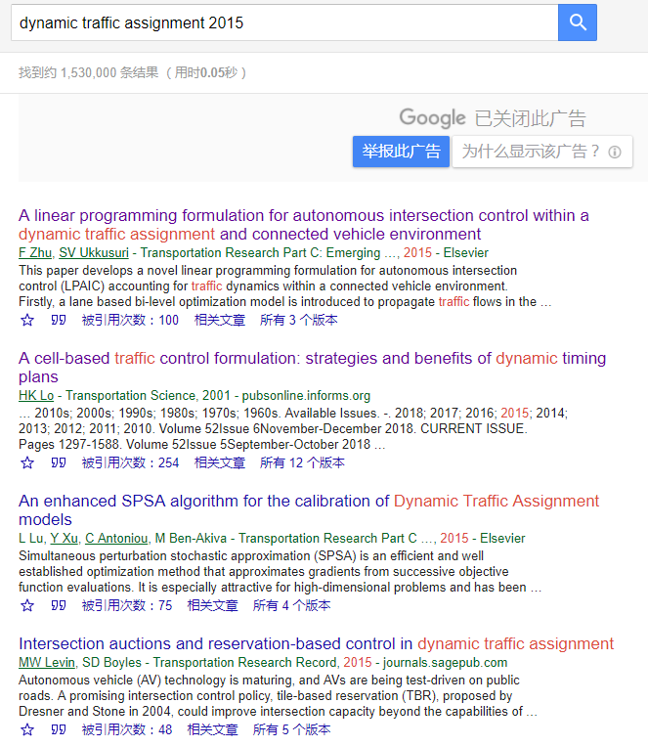
2.Literature limit
Add the year to the search phrase to get articles published in a particular year.

Slide 30
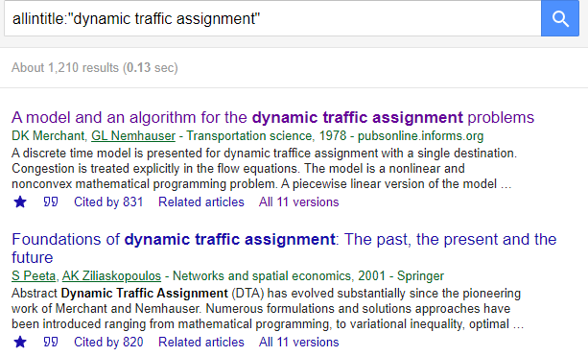
2.Literature limit
Allintitle: Limit to terms appearing in the title only.

Slide 31
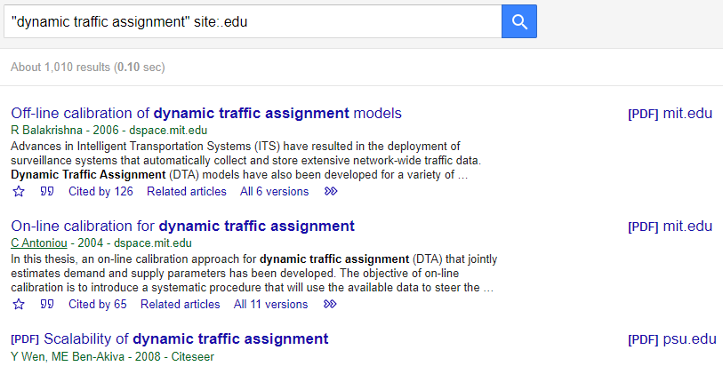
2.Literature limit
Site: Limit your search to certain websites or domains

Slide 32
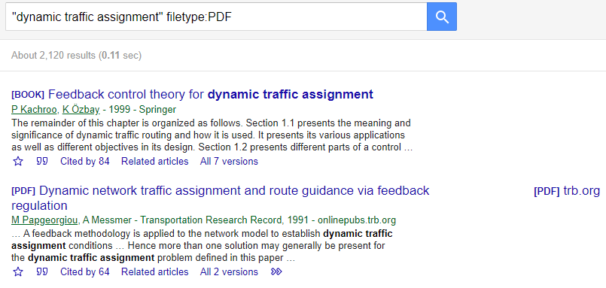
2.Literature limit
Filetype: Limit your search to specific file types.

Slide 33
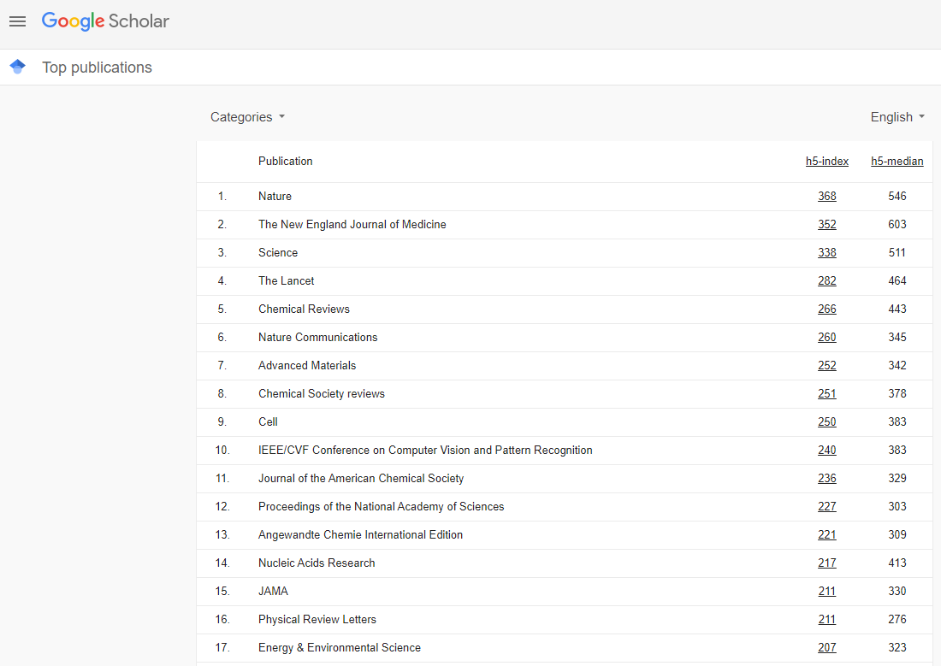
2.Literature limit
Search for articles published only in top journals.

Slide 34
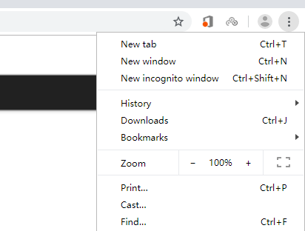
3.Literature expansion
Search in incognito mode for better results.
Previous search data is used to influence the search results that you see the next time you run a search. It’s not so great if you are trying to find academic content on any particular subject.

Slide 35
4 LITERATURE MANAGEMENT
1.My Library
2.Citation Organization
3.Useful Links
4.Alerts

Slide 36
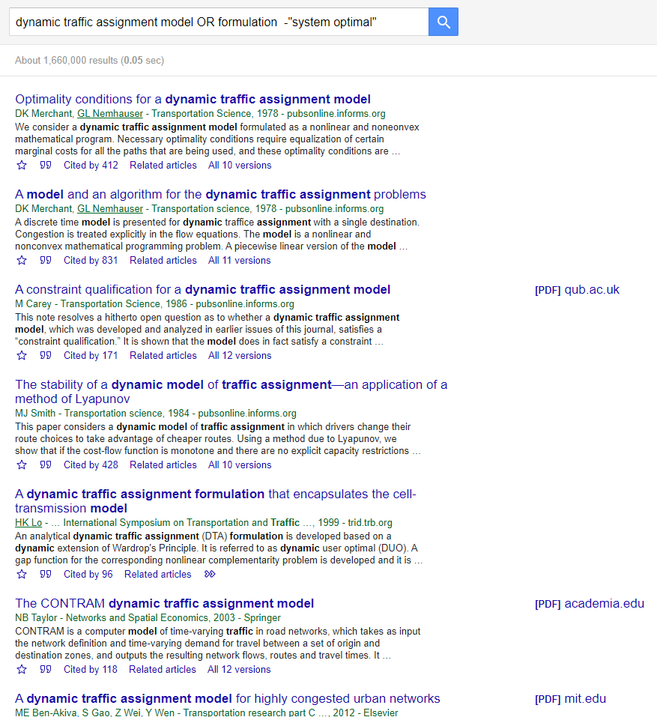
1. My library
Star an article to add to your library.

Slide 37
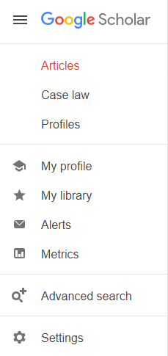
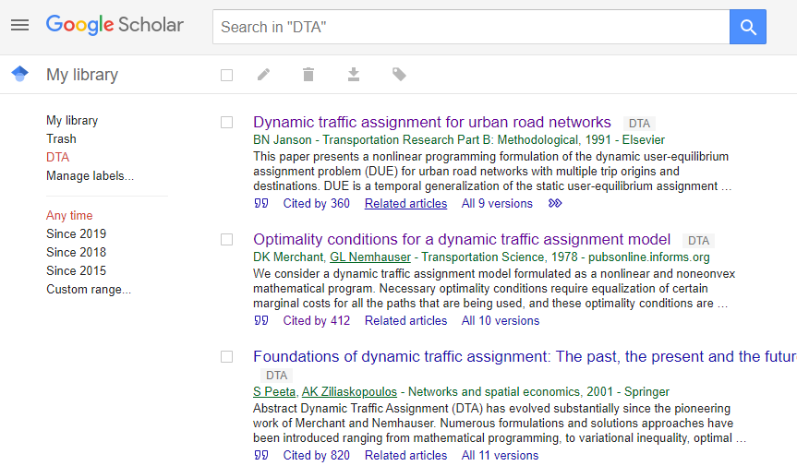
1. My library
Create your own library for specific research topics.

Slide 38
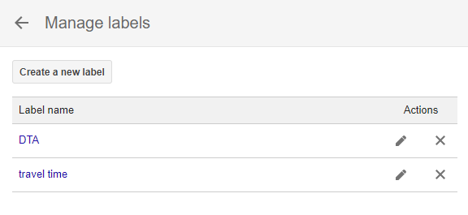
1. My library
Create your own library for specific research topics

Slide 39
2. Citation organization
Organize and automate your citations.

Slide 40
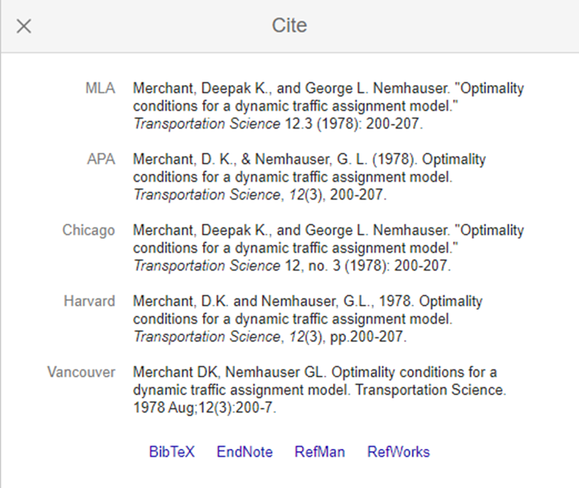
2. Citation organization
Organize and automate your citations.
commonly used citation formats such as MLA, APA, Chicago, Harvard, and Vancouver that may be copy and pasted.
links for exporting the citation data as BibTeX or RIS.

Slide 41
3. Useful links-Author
This link will bring you to the publisher’s page.

Slide 42
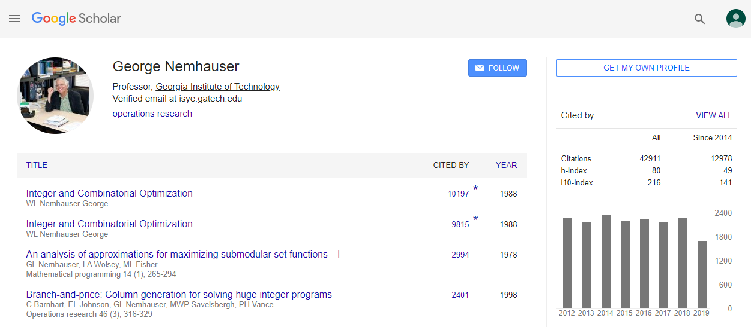
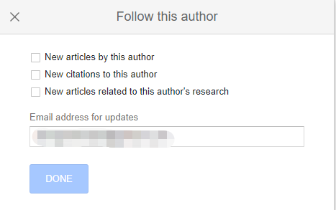
3. Useful links-Author
You can follow your favorite author.

Slide 43
3. Useful links-Cited by
The Cited by link will show other articles that have cited this resource. It useful to trace an idea from its original source up to the present.

Slide 44
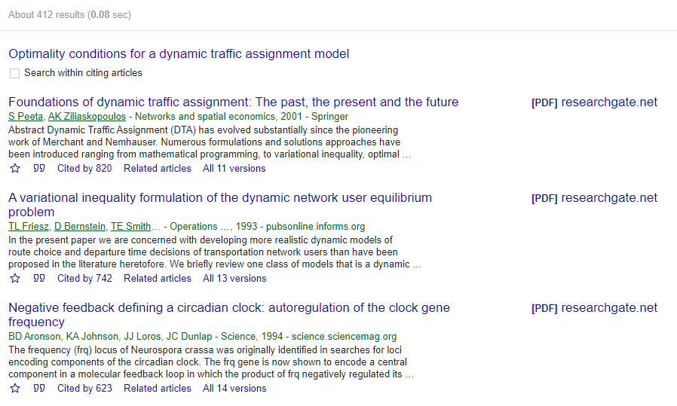
3. Useful links-Cited by

Slide 45
3. Useful links-Related articles
The Related articles link will show more relevant materials.

Slide 46
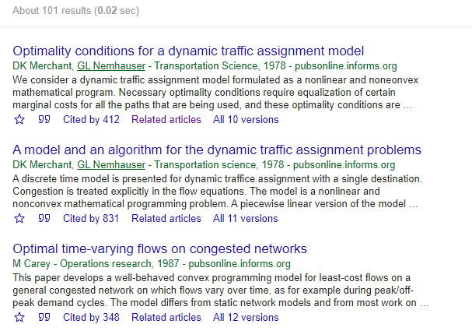
3. Useful links-Related articles

Slide 47
3. Useful links-Versions
Versions link brings you different versions of the article.

Slide 48
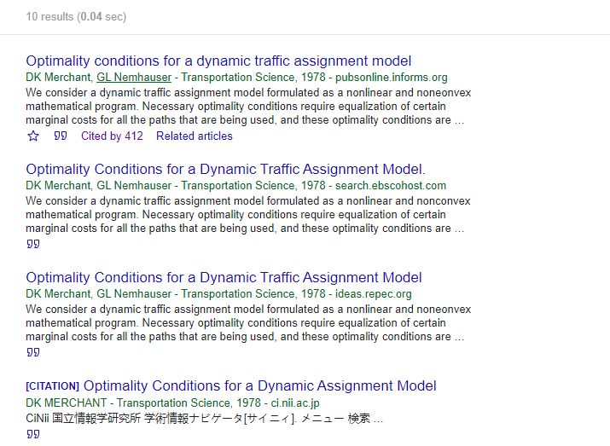
3. Useful links-Versions

Slide 49
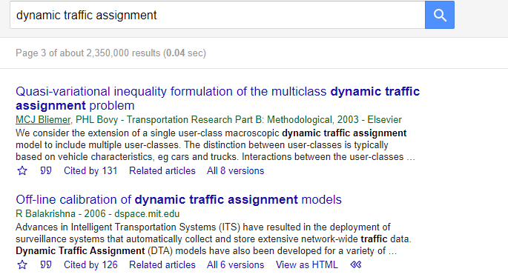
3. Useful links-View as HTML
Html versions of documents as follow.

Slide 50
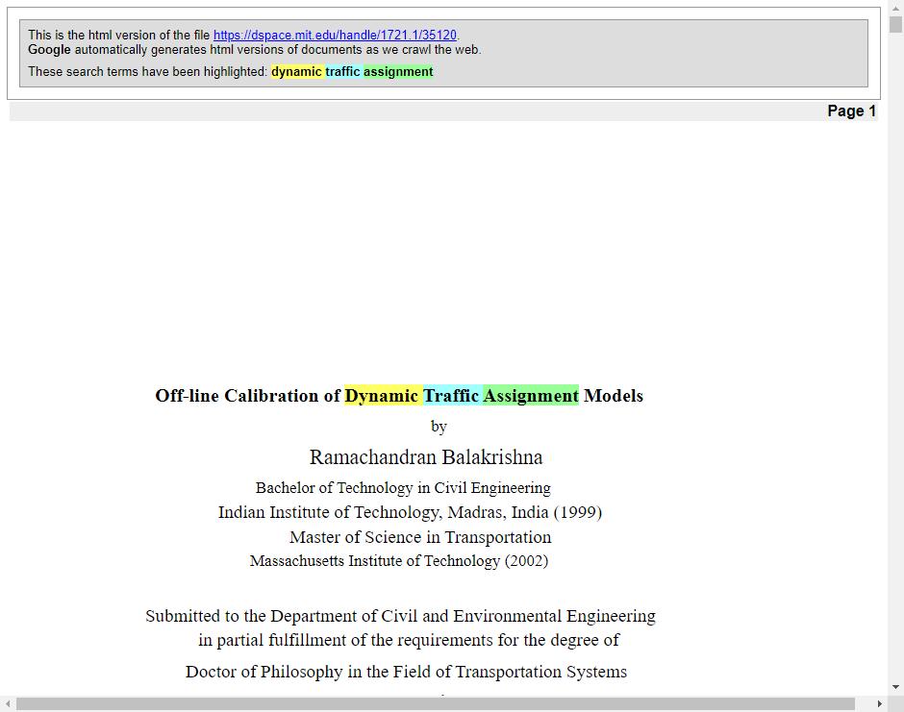
3. Useful links-View as HTML

Slide 51
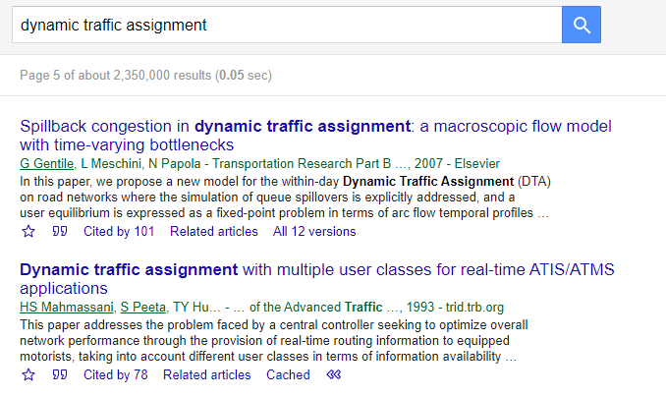
3. Useful links-Cached
The snapshot of the web page as follow.

Slide 52
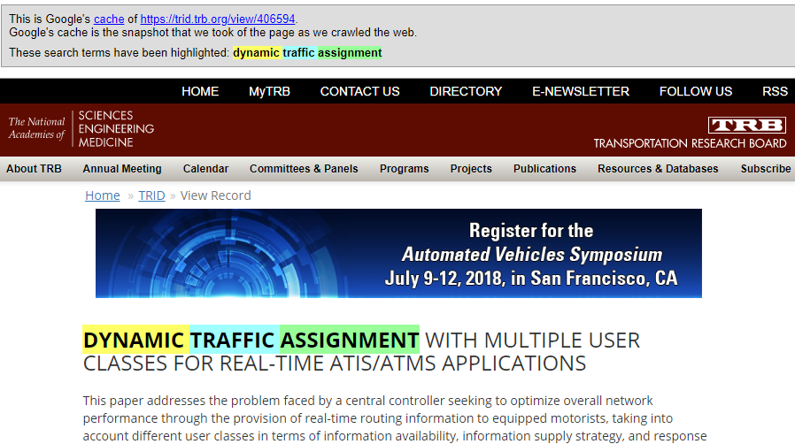
3. Useful links-Cached

Slide 53
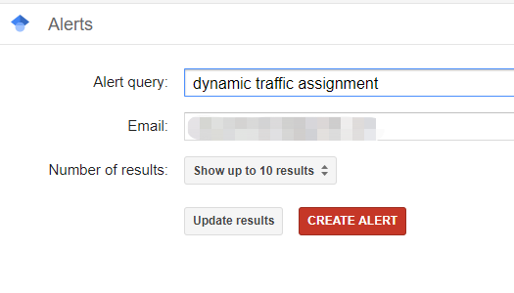
4. Alerts
Set up alerts to stay up-to-date on trending research literature.

Slide 54
5 Examples
1. begin with review articles
2. use “cited by” to track
3. track the well-known experts’

Slide 55
1. Begin with review articles
A review article surveys and summarizes state-of-the-art on a topic (survey/overview articles).
Review articles identify:
active researchers in the field
state-of-the-art
pros and cons
significant gaps
future research directions
......

Slide 56
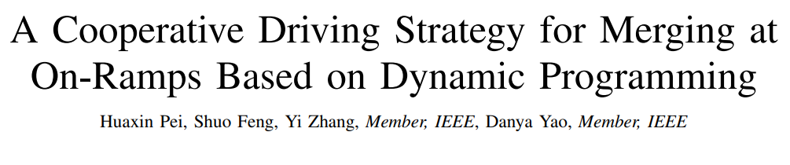
1. Begin with review articles
E.g.1:
We interest in the flow merging control problem and happen to come across this individual piece of paper

Slide 57
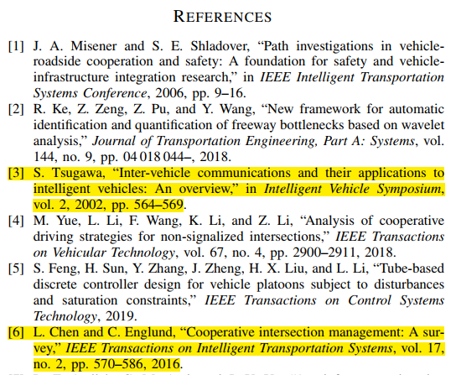
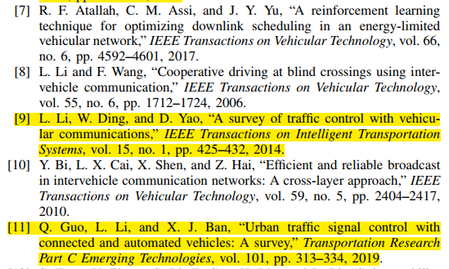
1. Begin with review articles
Scan the references to identify the review articles;
Pay attention to the published year of the articles;
State-of-the-art; pros and cons; significant gaps; future research directions

Slide 58
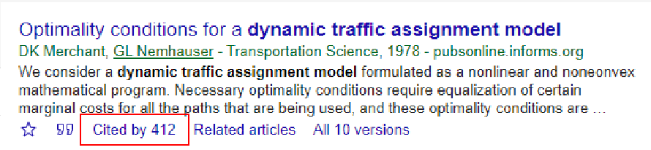
2. Use “cited by”
One article may very close to your topic, you can search for this paper again and click “cited by” button to read more details of relavent research.

Slide 59
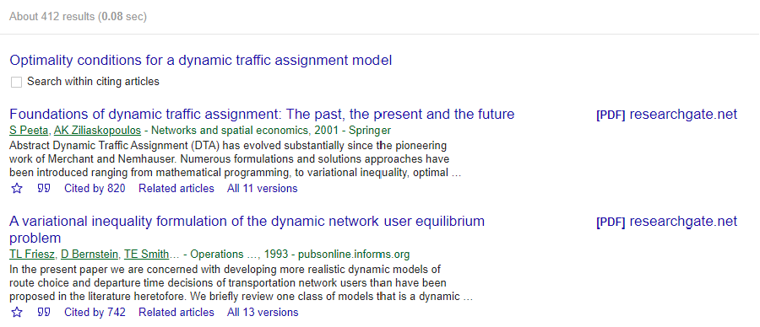
2. Use “cited by”
One article may very close to your topic, you can search for this paper again and click “cited by” button to read more details of relavent research.

Slide 60
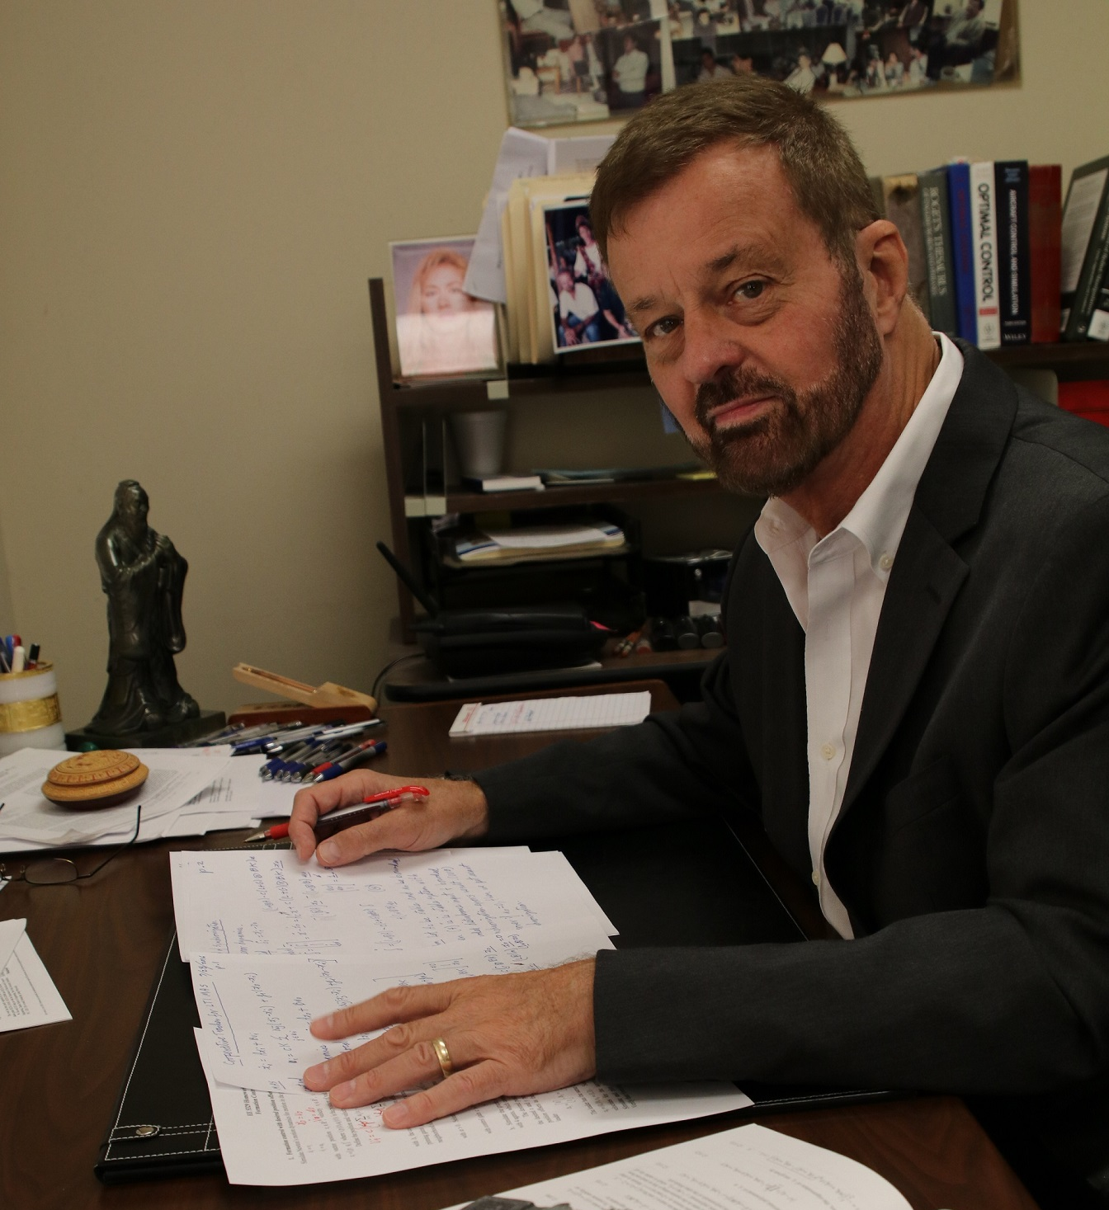
3. Expert’s homepage
Prof. Frank Lewis is one of the top guns in reinforcement learning & control theory

Slide 61
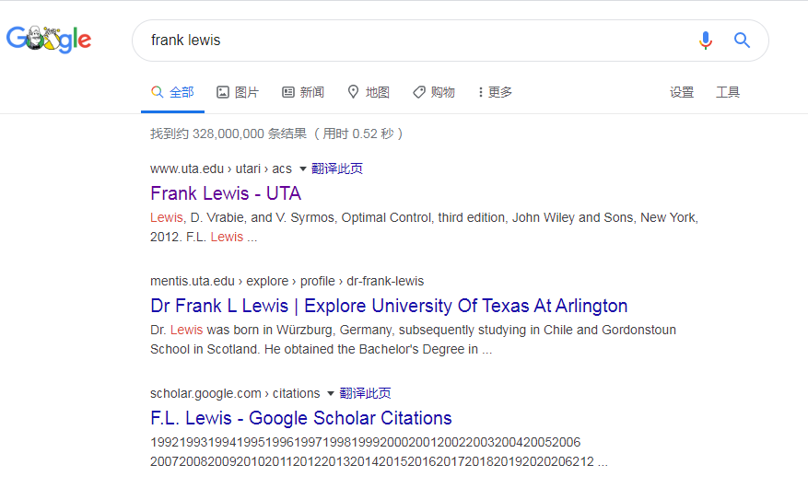
3. Expert’s homepage
Search and visit his personal website

Slide 62
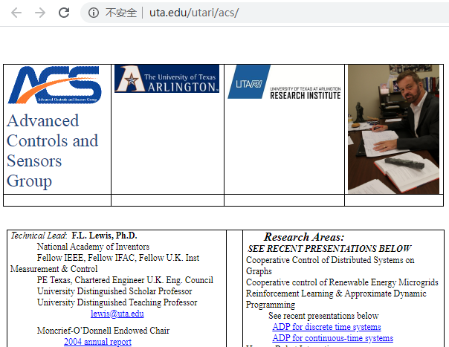
3. Expert’s homepage
Search and visit his personal website

Slide 63
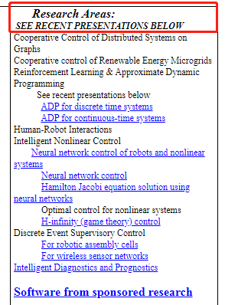



3. Expert’s homepage
Research areas, main books, presentations, group members...

Slide 64

3. Expert’s homepage
Useful resources can be found

Slide 65


1.Effective tips
1. keywords:
best describe your topic
2. phrases :
use quotes to search for an exact match.
3. synonyms:
include alternative terms in your search

Slide 66


1.Effective tips
4. Boolean operations:
more relevant materials
5. advanced search
for complex queries
6. My library
create library for a specific research topics

Slide 67


1.Effective tips
7. citation:
organize and automate citations
8. useful links:
for publisher’s homepage, relevant papers…
9. alert
set alert for a specific query
10. other useful tips
……

Slide 68
THANKS
计算机工程学院 软件工程141班

